Slide 1
  Open Booking
  Wishful Thinking or Impending Reality?
Presented by:
Mike Koetting, EVP Supplier Management
Concur

Slide 2
Agenda
  Open Booking Definition
  Relevant Trends
  Industry Solutions
  Travel Managers’ Perspectives
  Audience Q & A
  Wrap-up

Slide 3
What is Open Booking?
Range of answers:
  “Do whatever you want”!
  Travel credits (Google approach)
  Aggregate bookings from several tools (e.g. hotel consolidators, rail systems)
Core concepts:
  Report from anywhere
  Extend influence of travel program

Slide 4
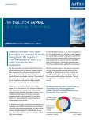
The Wire – an AirPlus Publication
Open Booking attitudes of nearly 100 travel managers
I have concerns about data capture 79.3%
I don’t know how I’d track travelers for safety and security purposes 72.8%
I could not support my supplier relationships 60.9%
I don’t trust my travelers to make good decisions 39.1%
It increases traveler satisfaction 34.8%
I trust my travelers to make good decisions 17.4%
There is potential to better control budget 12.0%
I believe it would boost compliance 4.3%
* Source: US AirPlus Survey Published Dec 2012

Slide 5

Open Booking
Open Booking is NOT an alternative to managed travel, it’s an additional option for companies looking to manage traveler behavior that is already occurring now.
Notes:
Open Booking is not an alternative to managed travel, it’s an additional option for clients looking to manage traveler behavior that is already occurring now.
Concur is focused on defining a path forward that faces this reality and addresses the needs of our corporate clients and their millions of travelers.

Slide 6


Content Distribution Costs
Explosion of Content
Notes:
The cloud – public and private – will drive distribution costs through the floor. I don’t need to a TV station, a publisher, or a record store anymore. I need YouTube, Kindle, and iTunes. I can get my content there for free.
Thus, content will explode. When content distribution costs go down, the amount of content goes up. Simple. More bands can make music, more authors can write books, and more crazy people can have their own shows. IT’S FREE! And, while some may argue this point, I would counter it is a good thing for the world. We are unleashing the talent of the world. Can you feel that?
But now that all of that content is there, there is too much out there? It’s a cluttered jungle, how do I find what I want? Search will need to “verticalize” in order to deal with the explosion. Got it.
What the hec does that mean? It means that you won’t just go to a broad search site for everything, you will go to search sites dedicated to the areas you are really searching for. The broad search sites give me too much bogus data. When I am searching for something specific, I want to get serious about it. Pinterest, anyone?

Slide 7
Travel consultant
Hotels
Traveler
TMC
GDS
Car rentals
Online booking tool
Airlines
Notes:
If you work for a company with a managed travel program, there’s only one approved way to book your travel – through a TMC and a GDS. There’s nothing wrong with that model – Concur has a very successful business built on that traditional process. But that narrow process doesn’t reflect the reality of today.

Slide 8

change is happening
WITH OR WITHOUT
employers
70%
Employees use personally owned devices to access company data and systems
Source: IDC
Notes:
Message:
This change is happening with or without employer support.
Supporting Points
A recent IDC study reports
According to IT 40% employees use personally owned devices to work to access privileged company info. - not issued by IT
According to employees, actual use reported close to 70%
This is a recent trend known as BYOD Bring Your Own Device,
Its clear the cultural of work is changing but what does it mean for the business?

Slide 9


Data Facilitates The “Wants” and “Needs”
With the control the company needs…
Capture Relevant Data
Cost optimization
Proven policy compliance system
Travel risk management
Reporting & business intelligence
What travelers want…
Booking Options
Budgets not Rules
Social/mobile tools
Localized service
I want…
I need…
Notes:
Orbitz for Business value proposition – providing a consumerized experience for the traveler (same familiar and easy-to-use experience as Orbitz leisure travel site) with the consistent innovation and partnership to address company needs
Powerful FamiliarBrand: Building traveler confidence through our highly recognized brand and familar online booking experience
Complete End-To-End Travel Service Model – Bringing you and your travelers full service, fully intergrated corporate travel solutions
Industry Changing Innovations: First to market on leading industry features and services
Cost Savings: Delivering 10% - 20% annually
Comprehensive Content: Vast supplier inventory at rates negotiated with global clout
Superior Traveler Care: Patented traveler alert system and smart tools to better manage travel risk
On Demand Reporting: Delivering real time data and highly effective dashboards
Focus on Superior Customer Service: Customer centric certification and training
Global Footprint: Flexible global technology and recognized local presence
Mobile Solutions: Easy, assessible, policy driven bookings made via all web-enabled devices

Slide 10
Open Booking is all about Data Access and Data Quality
Supplier Connections
GDS
Mid-Office
Your Travel Data
Employee Email
Card Data
Agent UI
Flat Files
Travel Reporting, Quality Assurance, Security, Service and Expense Reporting

Slide 11
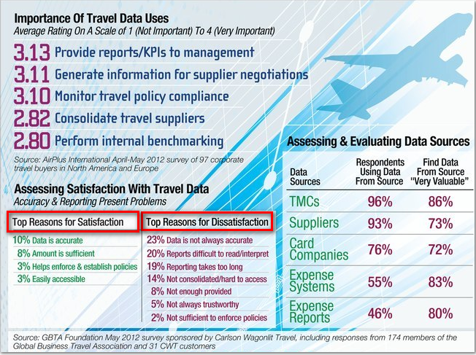

Slide 12

Challenges with Travel Data Today
Data Capture – historically inconsistent & incomplete
Data Consolidation– data elements & formats are dissimilar
Data Completeness – missing key elements of travel record used for reporting & analysis

Slide 13






Emerging Industry Solutions
Supplier | Product | Brief Description
 | Open Booking | Enhanced version of Concur Travel Indirect – forward itineraries to plans@concur.com Direct – link your Concur profiles with suppliers’
 | Worldmate | Organize all itineraries and integrate them with the CWT agent desktops
 | TripLink | Links trip components from multiple sources into TLRs (TripLink Records) stored in Centralized Travel Repository (CTR).
 | Bookit | Shop, reserve anywhere; forward to Shorts to book
 | ProcureApp | Embedded “Badge” sends reporting data securely to mid/back office, security, expense report, or all the above.

Slide 14
Open Booking Video
Please see the Open Booking Overview Video at Concur.com

Slide 15
Why is Open Booking good for your company?

Slide 16


Open Booking addresses the Social, Mobile and BYOD trends that are transforming corporate travel
Open Booking strengthens managed travel by trusting and enabling travelers to make smart purchasing decisions and bringing the data back to the travel manager.
Only 21% of business travelers are under mandated programs
47% of business travelers are lightly managed, with “travel guidelines”

Slide 17

Open Booking Direct strengthens managed travel
Appeals to businesses of all sizes by addressing the weaknesses caused by program leakage
Missed supplier discounts
Poor travel policy enforcement
Incomplete spend analysis
Ineffective Safety and Security procedures
Inefficient expense reporting

Slide 18
Why is Open Booking good for the TMC?

Slide 19
Open Booking fulfills the premise of a TMC
Manage ALL Corporate Travel
Mega TMC Whitepaper
54% of travelers…
…book outside of their companies’ recommended hotel booking channels.
Notes:
AMSTERDAM, July 31 2012 – New research from Carlson Wagonlit Travel (CWT) has shown that on average 54 percent of travelers book outside of their companies’ recommended hotel booking channels, even in the most carefully managed travel programs.
Using Concur’s Open Booking – Agent or the Itinerary Services API TMCs can gain visibility to Open Booking reservations. This integration:
Gives travel consultants the ability to see and service ALL of the travelers reservations
Brings new accuracy to procurement analytics
Ensures the effectiveness of Safety and Security services

Slide 20
History doesn’t repeat itself,
but it does rhyme.
Mark Twain

